Slide 1



How to Follow a Cost–benefit Analysis in a Decision-making Scenario
Mujtaba SP22-BSE-036
Hasaan SP22-BSE-017
Malaika SP22-BSE-025
Musa SP22-BSE-043
Haider SP22-BSE-033
Ayesha SP22-BSE-008

Slide 2
Agenda
Introduction
Brief History
When/How to Use the Tool
Its Flaws
Summary

Slide 3

Introduction
CBA is a technique used for non-critical financial decisions.
Not used when decisions are mission-critical, or when large sums of money are involved.
In simpler words, “Deciding, Quantitatively, Whether to Go Ahead”.
3

Slide 4
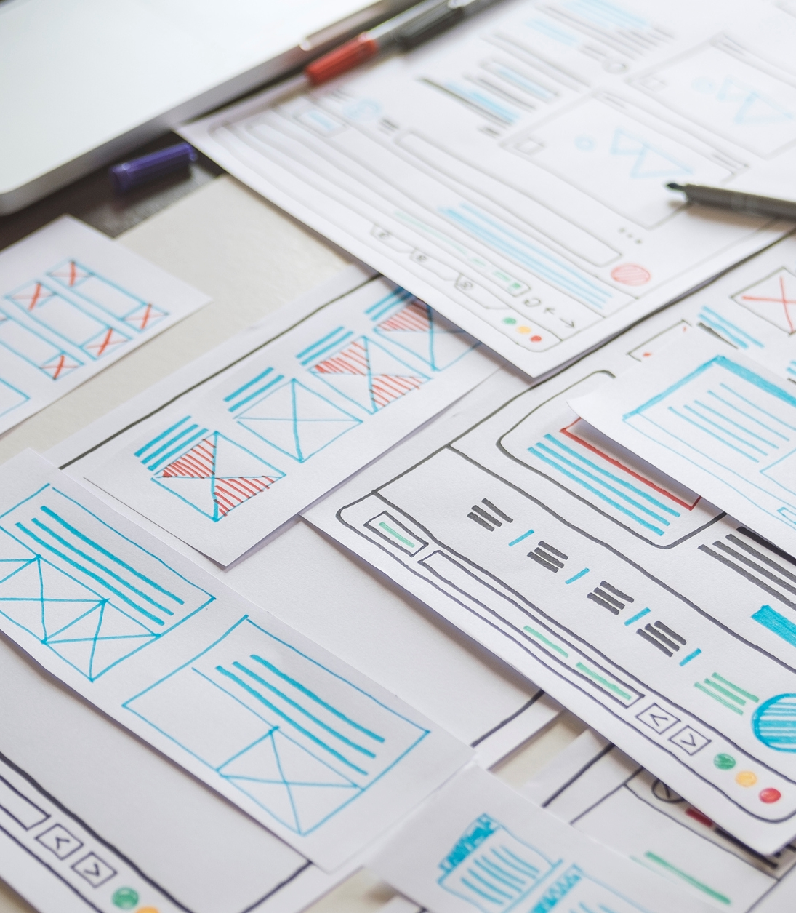
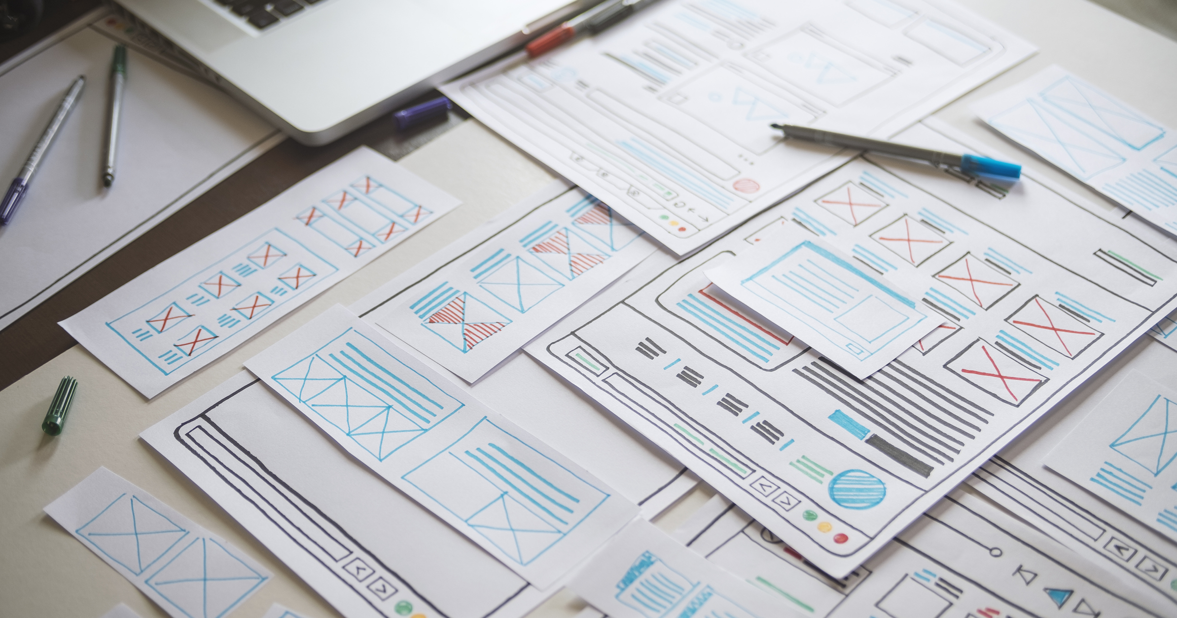
Brief History
How it all started?
Jules Dupuit, a French economist introduced the concepts behind CBA in the 1840s.
It became popular in the 1950s as a way of determining project costs and benefits.

Slide 5
When to Use the Tool
You can use the technique in a wide variety of situations. For example, when you are:
Deciding whether to hire new team members.
Evaluating a new project or change initiative.
Determining the feasibility of a capital purchase.
How to Follow a Cost–benefit Analysis in a Decision-making Scenario

Slide 6
How to Use the Tool
You should follow these 4 steps:
Brainstorm costs and benefits of your project.
Assign a monetary value to the costs.
Assign a monetary value to the benefits.
Compare costs and benefits, and decide your course of action.
How to Follow a Cost–benefit Analysis in a Decision-making Scenario

Slide 7
Flaws of Cost-benefit Analysis
Revenues can be hard to predict, making analysis less reliable.
It struggles in situations where project has cash flows that come in over number of periods of time.
7

Slide 8

Summary
Cost-benefit analysis is a straightforward method to decide whether to pursue a project.
All costs and benefits associated with project are calculated.
Analysis can then be made to decide, “Whether to Go Ahead”.
8

Slide 9




Thank you

